Slide 1
Object Detection

Slide 2
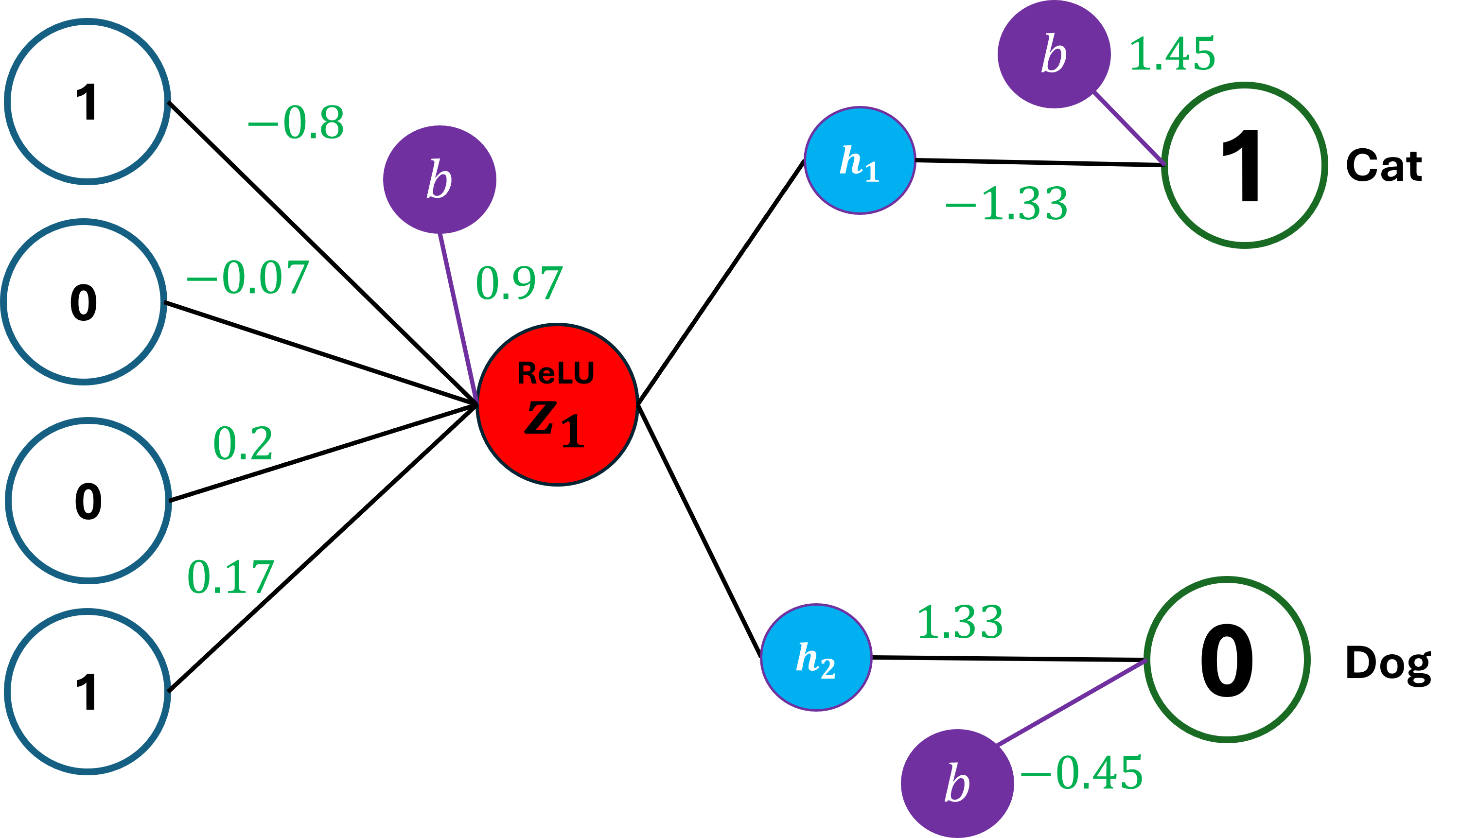
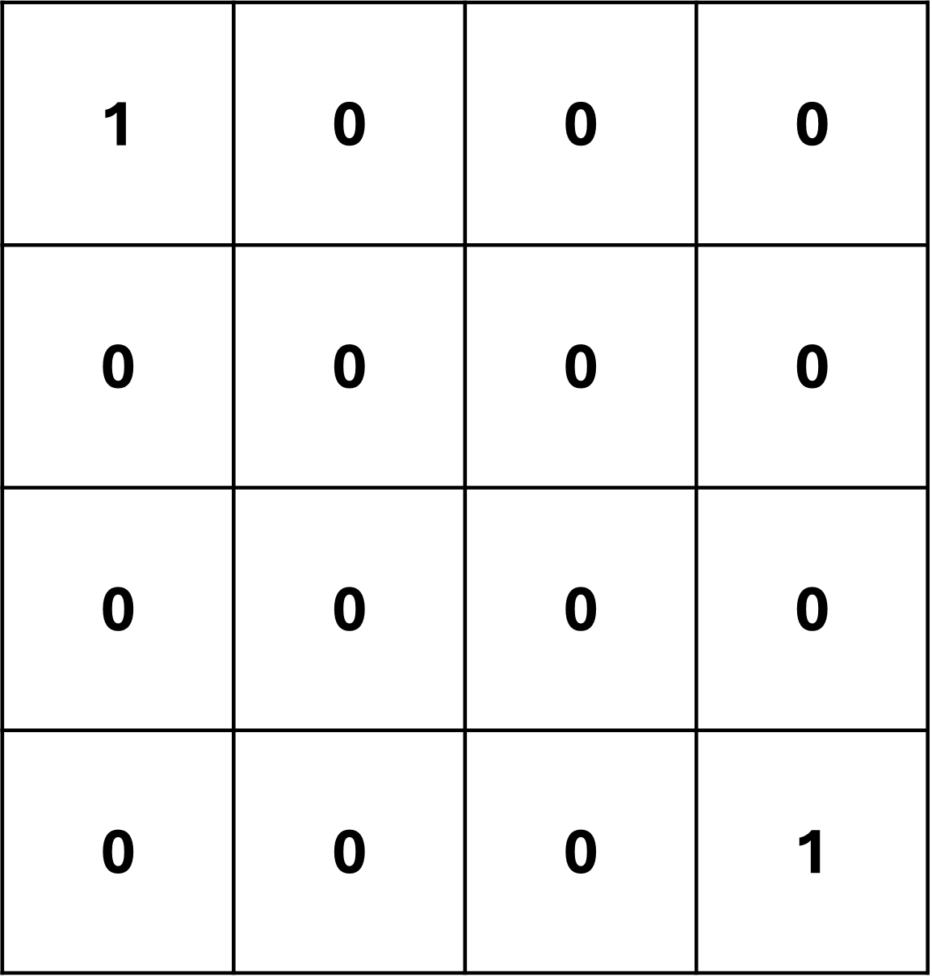
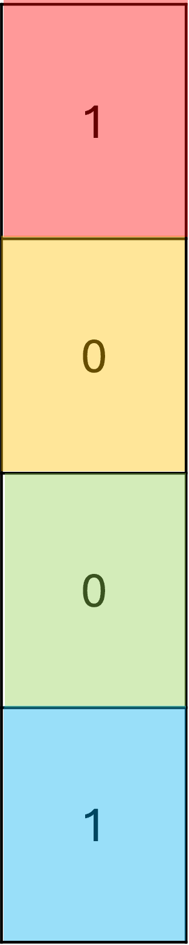
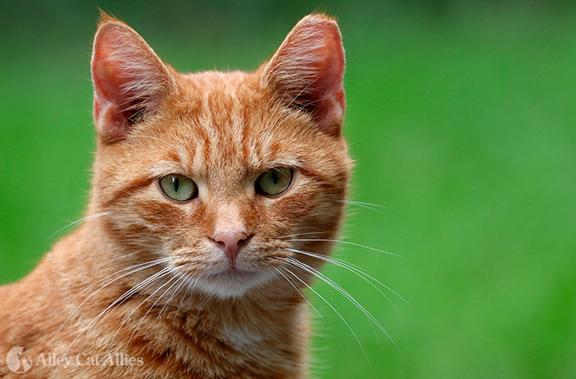
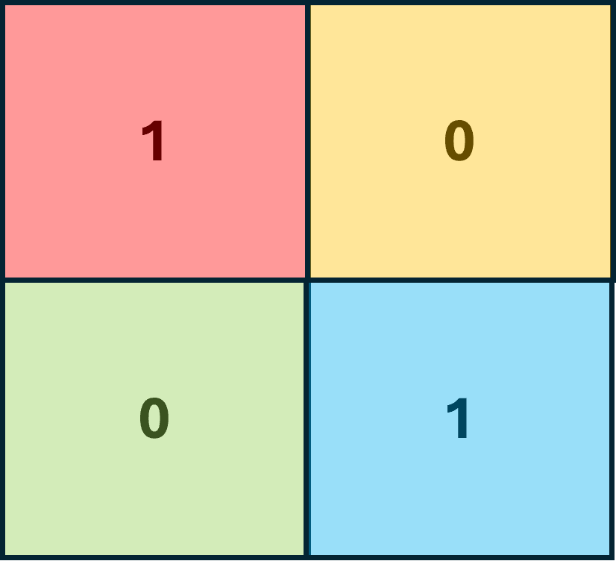
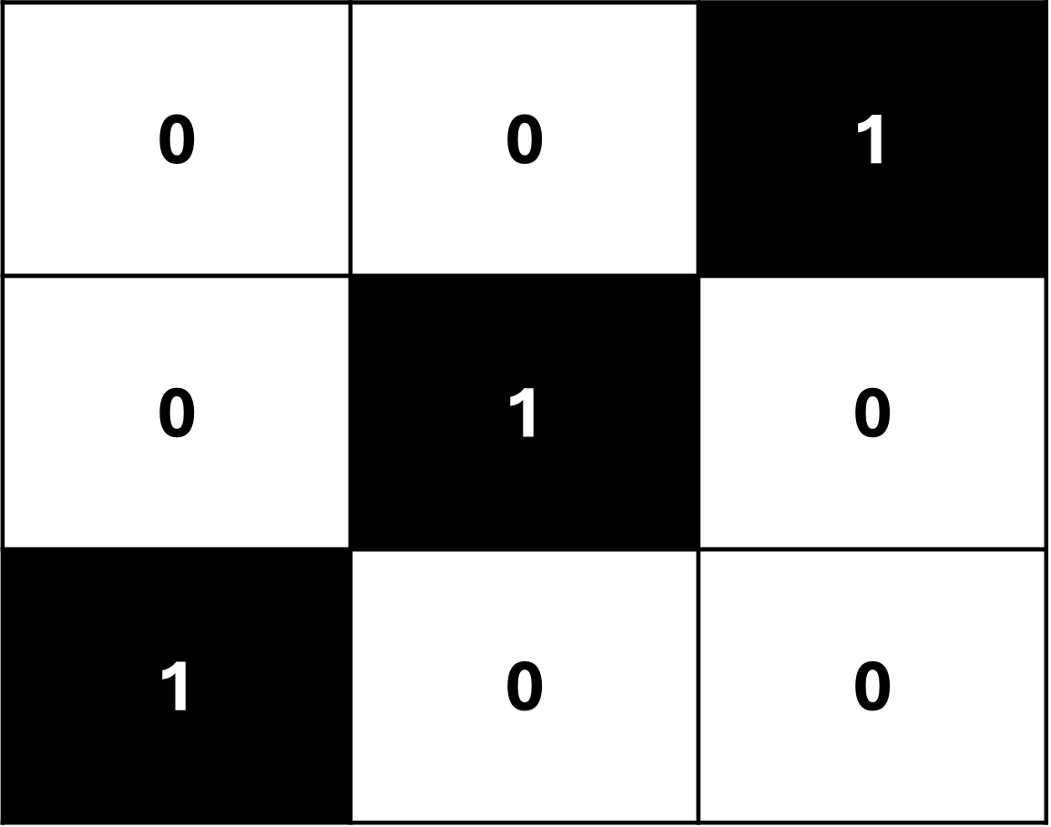
Recap on Convolutional Neural Networks
Filter
Input Image
Feature Map
Max pooling
Convolutional layers
Fully Connected Layer
This is where we extract the features an image
This is where we classify the image based on its the features

Slide 3
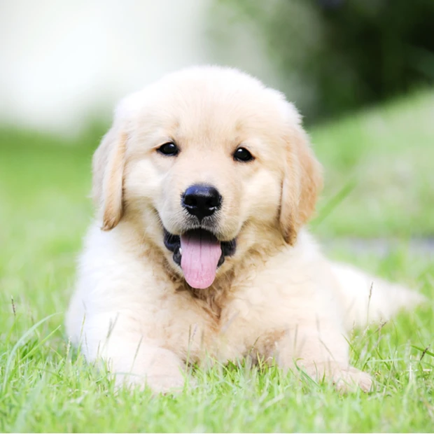
Object Detection
The task of assigning a label and a bounding box to all objects in an image

Slide 4
Bounding Box
In object detection, a bounding box is a rectangle drawn around a region of interest in an image.

Slide 5
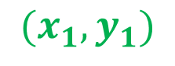
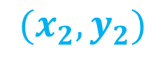
$$(x_{1},y_{1})$$
$$(x_{2},y_{2})$$
A bounding box is determined by the x and y coordinates of the upper-left corner of the rectangle and the such coordinates of the lower-right corner

Slide 6
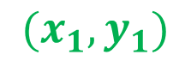
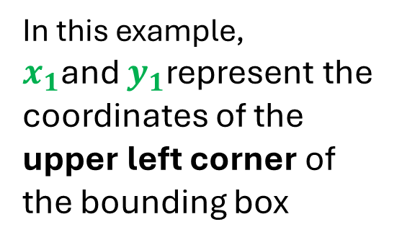
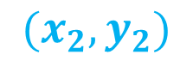
$$(x_{1},y_{1})$$
In this example,
$x_{1}$and $y_{1}$represent the coordinates of the upper left corner of the bounding box
Height
Image Height
$$(x_{2},y_{2})$$
Width
Image Width

Slide 7
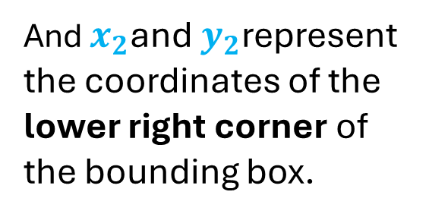
$$(x_{1},y_{1})$$
And $x_{2}$and $y_{2}$represent the coordinates of the lower right corner of the bounding box.
Height
Image Height
$$(x_{2},y_{2})$$
Width
Image Width

Slide 8
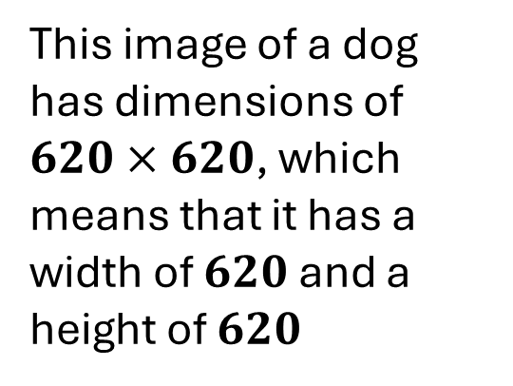
$$(x_{1},y_{1})$$
This image of a dog has dimensions of $620×620$, which means that it has a width of $620$ and a height of $620$
Height
620
$$(x_{2},y_{2})$$
Width
620

Slide 9
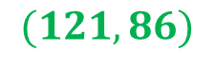
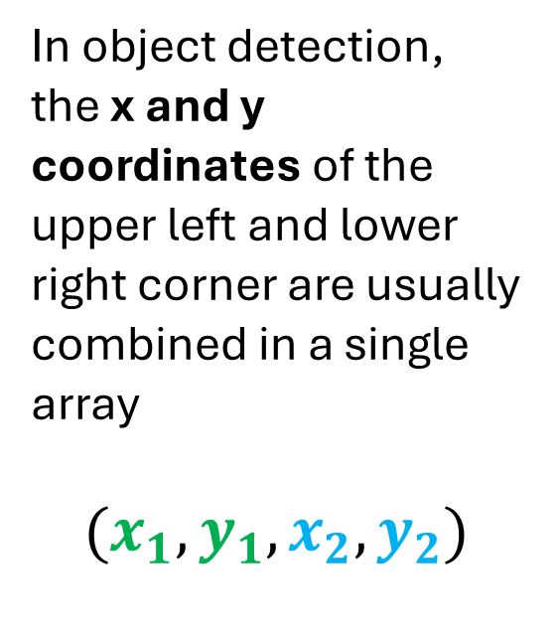
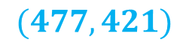
$$(121,86)$$
In object detection, the x and y coordinates of the upper left and lower right corner are usually combined in a single array
$$(x_{1},y_{1},x_{2},y_{2})$$
Height
620
$$(477,421)$$
Width
620

Slide 10
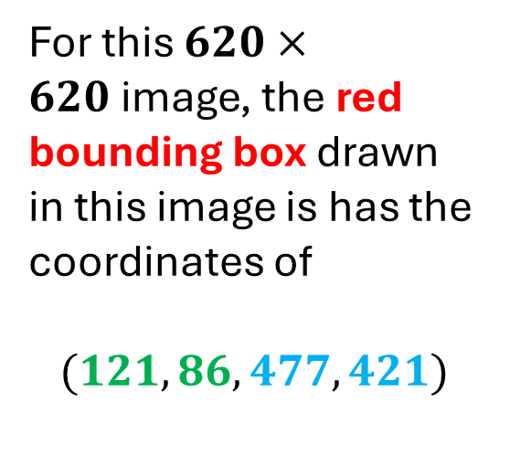
$$(121,86)$$
For this $620×620$image, the red bounding box drawn in this image is has the coordinates of
$$(121, 86, 477, 421)$$
Height
620
$$(477,421)$$
Width
620

Slide 11
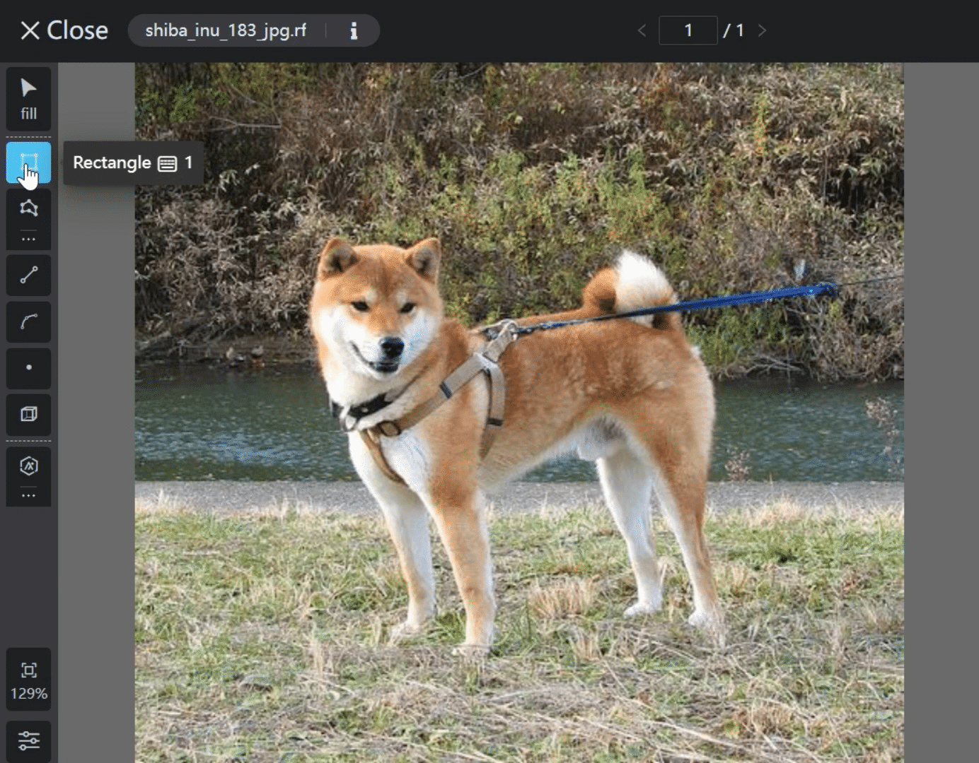
Drawing a bounding box in each image is usually done manually. In machine learning, this process is called annotation

Slide 12
Annotations can be done automatically with the use of pre-trained models such as YOLO but the preciseness of bounding box drawn may vary for each image

Slide 13
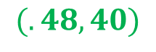
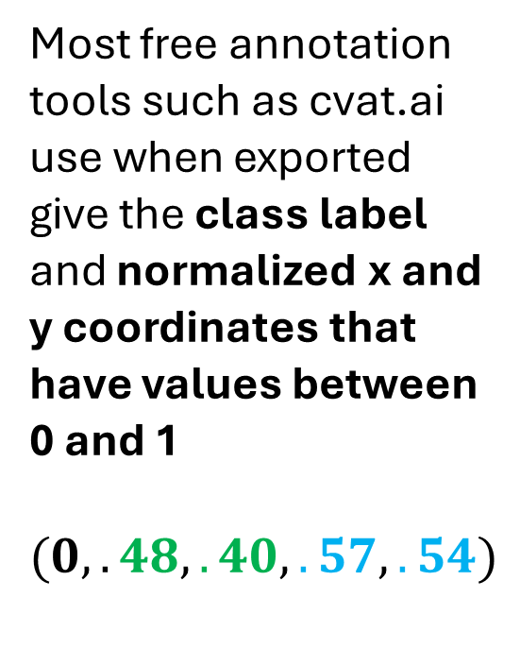
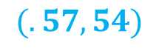
$$(.48,40)$$
Most free annotation tools such as cvat.ai use when exported give the class label and normalized x and y coordinates that have values between 0 and 1
$$(0, .48, .40, .57, .54)$$
Height
620
$$(.57,54)$$
Width
Class label
Coordinates
620

Slide 14
$$(.48,40)$$
These values are normalized because it is better to use normalized values when training a model to predict bounding box coordinates.
Height
620
$$(.57,54)$$
Width
620

Slide 15
$$(121,86)$$
However, we need to convert them back to their original pixel values before drawing the bounding box to an image.
Height
620
$$(477,421)$$
Width
620

Slide 16
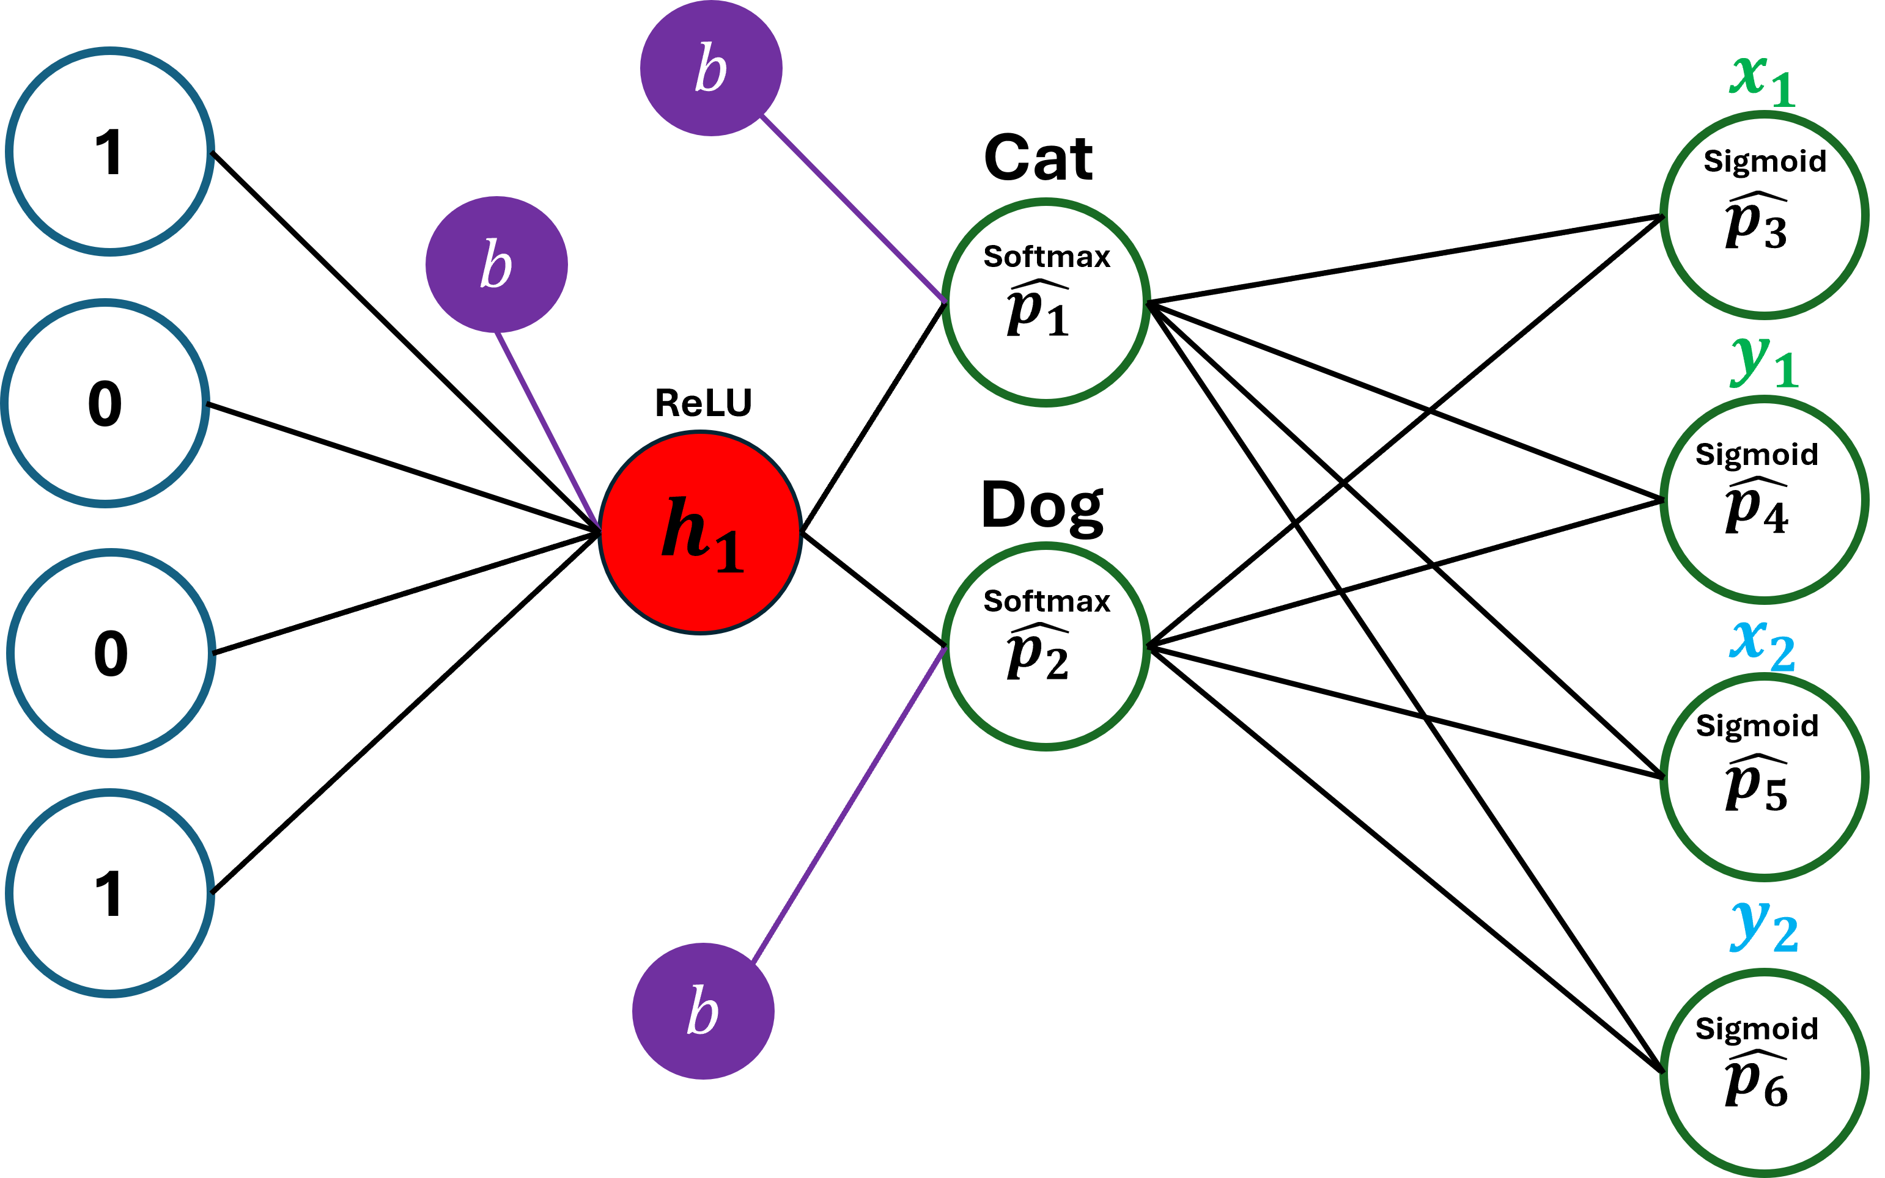
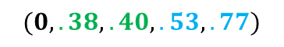
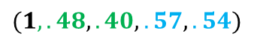
$$(1,.48, .40, .57, .54)$$
Filter
Feature Map
Max pooling
$$(0, .38, .40, .53, .77)$$
Convolutional layers
Fully Connected Layer
When training a model for object detection, our input would include the image, its label and the bounding box x and y coordinates

Slide 17
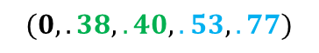
$$(1,.48, .40, .57, .54)$$
Filter
Feature Map
Max pooling
$$(0, .38, .40, .53, .77)$$
Convolutional layers
Fully Connected Layer
We also need to create an additional output layer in our fully connected layer

Slide 18



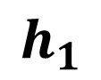
1
$$b$$
$$b$$
In classification, we only have two neurons in the Output Layer
1
Softmax
0
Cat
ReLU
$$h_{1}$$
0
0
Softmax
Dog
1
$$b$$
Input layer
Hidden layer
Output layer

Slide 19
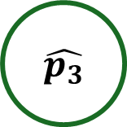
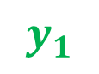


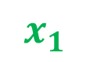



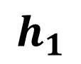
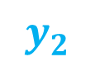



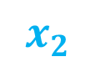
$$b$$
$$x_{1}$$
1
Cat
$$\hat{p_{3}}$$
Sigmoid
$$b$$
$$\hat{p_{1}}$$
Softmax
For object detection, we need add another Output Layer for the bounding boxes.
$$y_{1}$$
0
ReLU
$$\hat{p_{4}}$$
Dog
Sigmoid
$$h_{1}$$
0
$$\hat{p_{2}}$$
Softmax
$$x_{2}$$
$$\hat{p_{5}}$$
Sigmoid
1
$$y_{2}$$
$$b$$
$$\hat{p_{6}}$$
Sigmoid
Input layer
Hidden layer
Output layer
Output layer

Slide 20
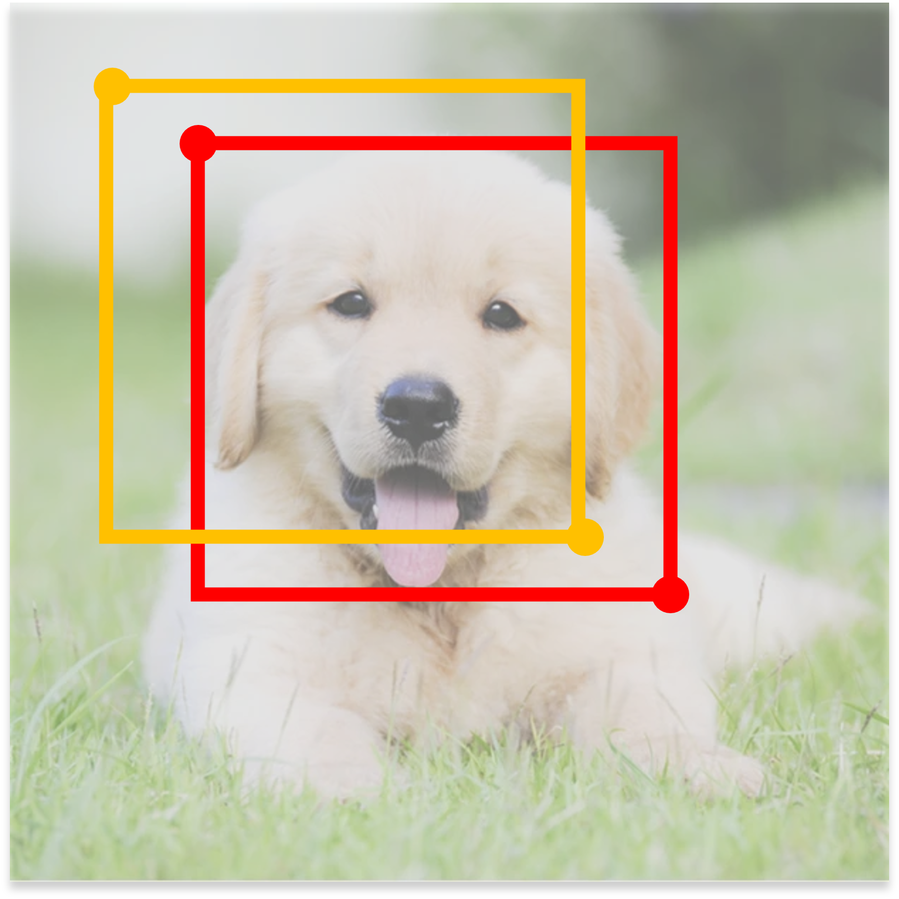
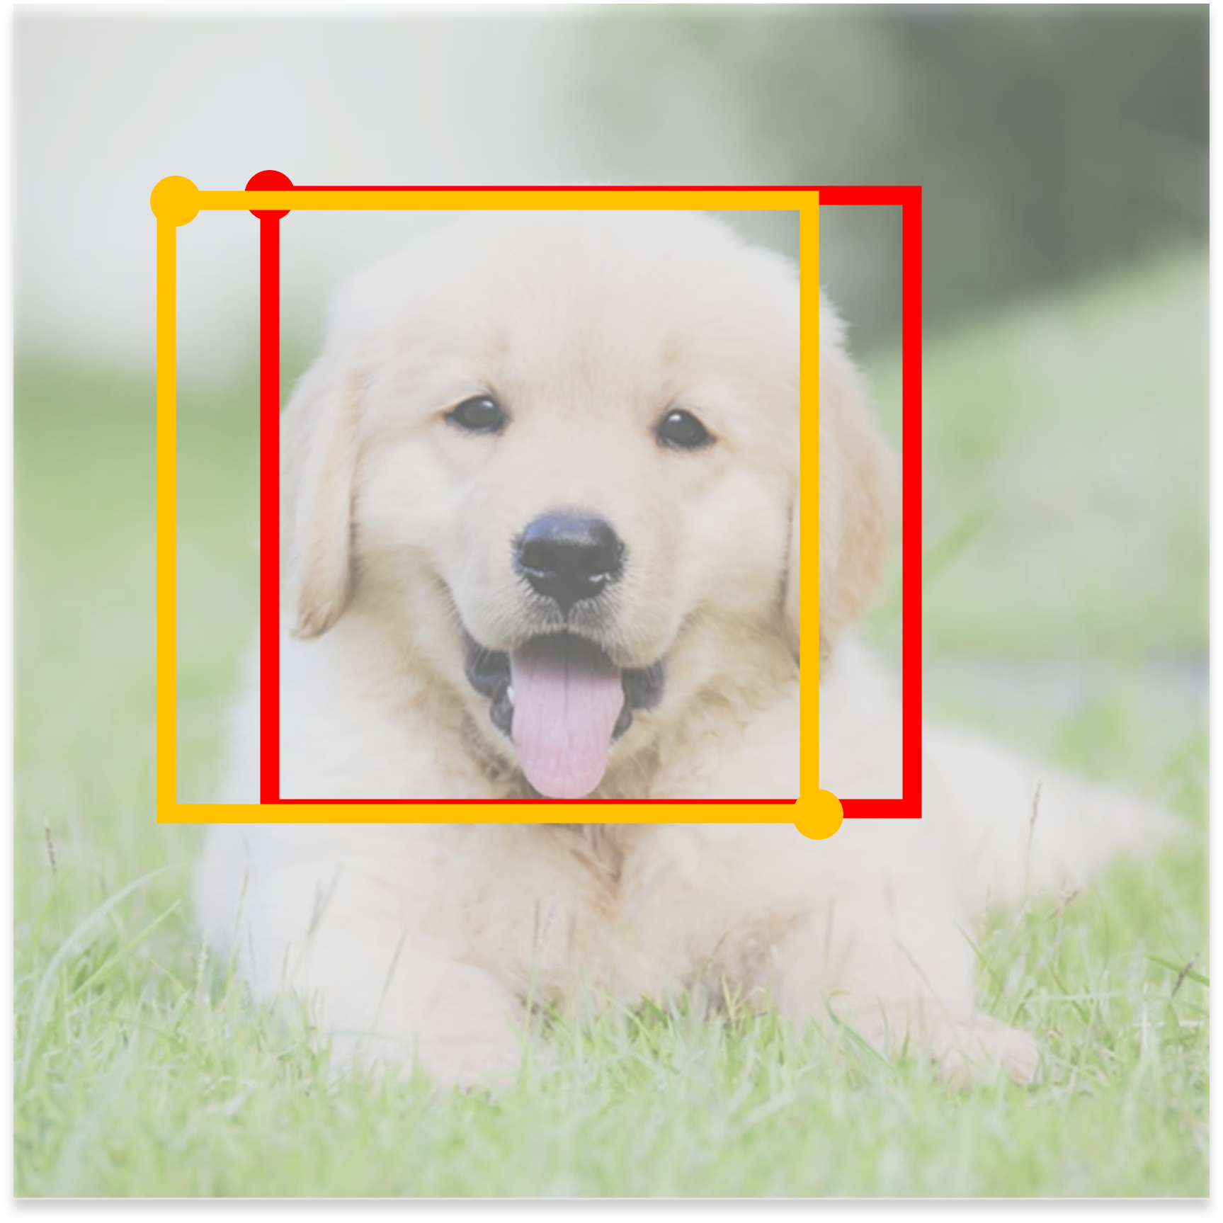
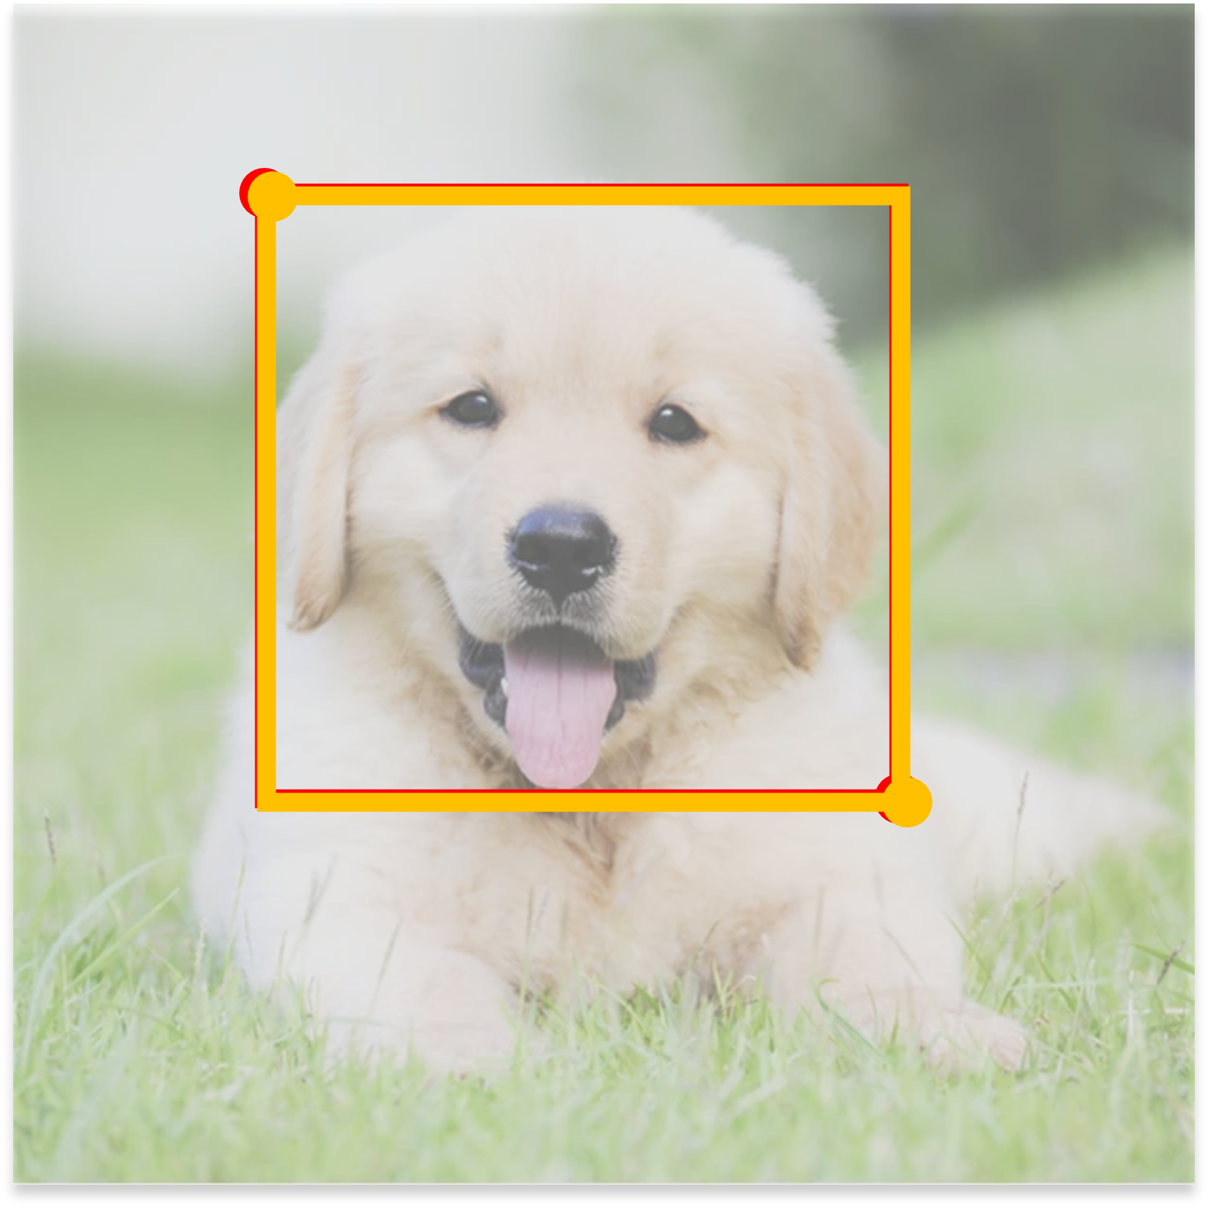
Epoch 1
Epoch 2
Epoch 3
During backpropagation, the weights are adjusted at using L2 loss so that the network predicts better bounding box coordinates at each epoch. This called bounding box regression

Slide 21
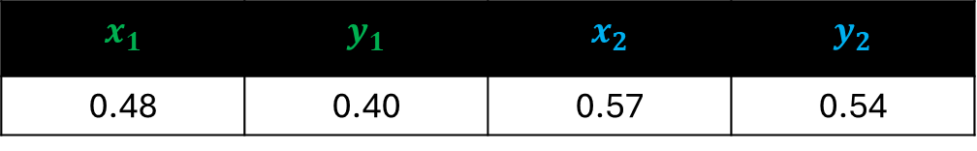
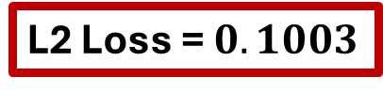
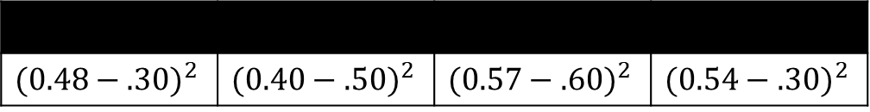
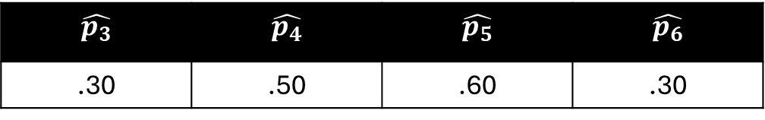
Expected
$$x_{1}$$ | $$y_{1}$$ | $$x_{2}$$ | $$y_{2}$$
0.48 | 0.40 | 0.57 | 0.54
Predicted
$$\hat{p_{3}}$$ | $$\hat{p_{4}}$$ | $$\hat{p_{5}}$$ | $$\hat{p_{6}}$$
.30 | .50 | .60 | .30
L2 Loss at Epoch 1
$${(0.48−.30)}^{2}$$ | $${(0.40−.50)}^{2}$$ | $${(0.57−.60)}^{2}$$ | $${(0.54−.30)}^{2}$$
L2 Loss = $0.1003$

Slide 22
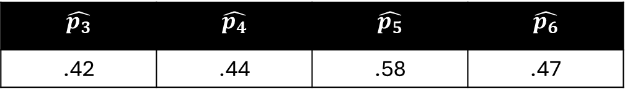

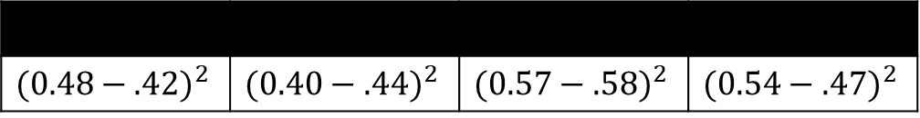
Expected
$$x_{1}$$ | $$y_{1}$$ | $$x_{2}$$ | $$y_{2}$$
0.48 | 0.40 | 0.57 | 0.54
Predicted
$$\hat{p_{3}}$$ | $$\hat{p_{4}}$$ | $$\hat{p_{5}}$$ | $$\hat{p_{6}}$$
.42 | .44 | .58 | .47
L2 Loss at Epoch 2
$${(0.48−.42)}^{2}$$ | $${(0.40−.44)}^{2}$$ | $${(0.57−.58)}^{2}$$ | $${(0.54−.47)}^{2}$$
L2 Loss = $0.0096$

Slide 23
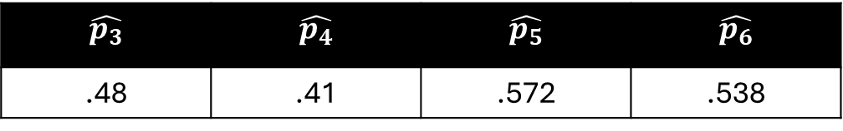
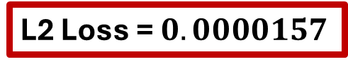
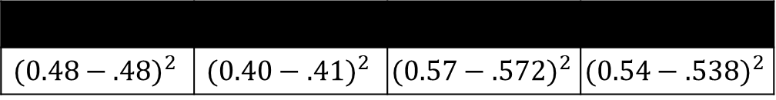
Expected
$$x_{1}$$ | $$y_{1}$$ | $$x_{2}$$ | $$y_{2}$$
0.48 | 0.40 | 0.57 | 0.54
Predicted
$$\hat{p_{3}}$$ | $$\hat{p_{4}}$$ | $$\hat{p_{5}}$$ | $$\hat{p_{6}}$$
.48 | .41 | .572 | .538
L2 Loss at Epoch 3
$${(0.48−.48)}^{2}$$ | $${(0.40−.41)}^{2}$$ | $${(0.57−.572)}^{2}$$ | $${(0.54−.538)}^{2}$$
L2 Loss = $0.0000157$

